Slide 1
Proposed Campus Wi-Fi Infrastructure
Course
Name
Institutional affiliation

Slide 2
abstract
This is a proposal plan Wi-Fi infrastructure to support the mobile devices within the triOS Kitchener Campus. The plan is taken in a bid to provide, fast and cost-effective Wi-Fi access within the campus block. As is, wireless communication has developed to become an integral part of life. The wireless technology has shaped an appropriation that has cut through industry stands to offer direction for solutions to the needs of the ever-increasing needs for internet-enabled mobile devices.

Slide 3
Introduction
According to Naughton (2016) the internet has evolved quickly to become the most significant heterogeneous point of device communication and infrastructure in the world. He cites that by 2014, statistical reports indicated that at least more than 3 billion people have access to the internet. Put into a perspective, the figure was almost half of the world population by that time.

Slide 4
Requirements for Reliable Wi-Fi
Roaming
In the field of IT (information technology), roaming means that devices can shift seamlessly from one WIFI access point to another (Walia, Hämmäinen and atinmikko, 2017). The shifting of the devices should also be devoid of any disruptions of the speeds of the internet enabled devices. Thus, it is imperative for the Wi-Fi within Kitchener Campus to be roaming. During the implementation face, adequate planning should be effected to ensure that different mobile devices can access the internet seamlessly without any backdrop and that the system can support all the devices.

Slide 5
Requirements for Reliable Wi-Fi
Redundancy
Redundancy in this context is the term that covers a backup plan in case of network failure of backlogs. Redundancy consists of additional elements that do not come primarily from the WLANS functionality. WLANs comes with several design specification, and each has its level of redundancy to fit its required purposes. The following factors influence choice of WLAN:
Increased population of the users, for example, when the number of students are many and hence the connected devices
The end-user
Application situations “Mission-critical and Non-mission-critical."

Slide 6
Requirements for Reliable Wi-Fi
Application Prioritization
The Wi-Fi within the campus location must be configured depending on the applications that are necessary for the organization. For example, a campus application can be said to be mission-critical. It is essential to understand that some applications are not critical and are also known as recreational. Therefore, the Wi-Fi within the campus must be designed in a manner that prioritizes application

Slide 7
Requirements for Reliable Wi-Fi
Adaptive radio management (ARM)
ARM is founded on the premise that even Wi-Fi networks need reasonable real-time management even though they run themselves when live (Vitek, 2016). In other words, it gives the options from which network issues can troubleshoot to accommodate and resolve any issues within the WLAN. The concept of integrating ARM into a busy network such as the campus type is likened to having a virtual engineer giving an around the clock monitoring of the Wi-Fi. In such sense, it is paramount for the campus Wi-Fi to be fitted with ARM as a means to mitigate network issues or loopholes inherent to the Wi-Fi.

Slide 8
Requirements for Reliable Wi-Fi
Security
A secure wireless system is a critical facet of the process of installation at the campus. The WLAN should be fitted with elements that can detect rogue access points and bar them from the network. Lack of security backups for the internet Wi-Fi makes the end-users and the systems vulnerable to security issues that might culminate into data loss, hacking and other possible threats.

Slide 9
Analysis of the triOS Kitchener Campus plan
Breakdown of key Wi-Fi hotspot areas:
Classrooms 15 +
Common area
Waiting area
Offices

Slide 10
Equipment Needed for Wi-Fi installation
Hardware
Access Points – Required = 50
    Cisco 1570 Outdoor Access Point (US $2,300.00)
    Aerohive (the AP170) (US $225.00)
    Aruba (the MSr2000 and the MSR4000) ($3295.00)
Wi-Fi Repeaters – Required = 50
    Plume Superpods 802.11b/g/n/ac (US$749.98)
    Netgear AC1200 WiFi Range Extender EX6150 (US$132)
    D-Link Wi-Fi Dual Band Range Extender DAP-1520 (US$54.65)
Software
Monitor access points: the controller will look at the amount of traffic that is going through he networks and offers solutions in case there is a problem within the access points. Tracking internet Wi-Fi usage: the controller is able to track the number of people logged on the Wi-Fi by using specific internet protocol (IP) for each device

Slide 11
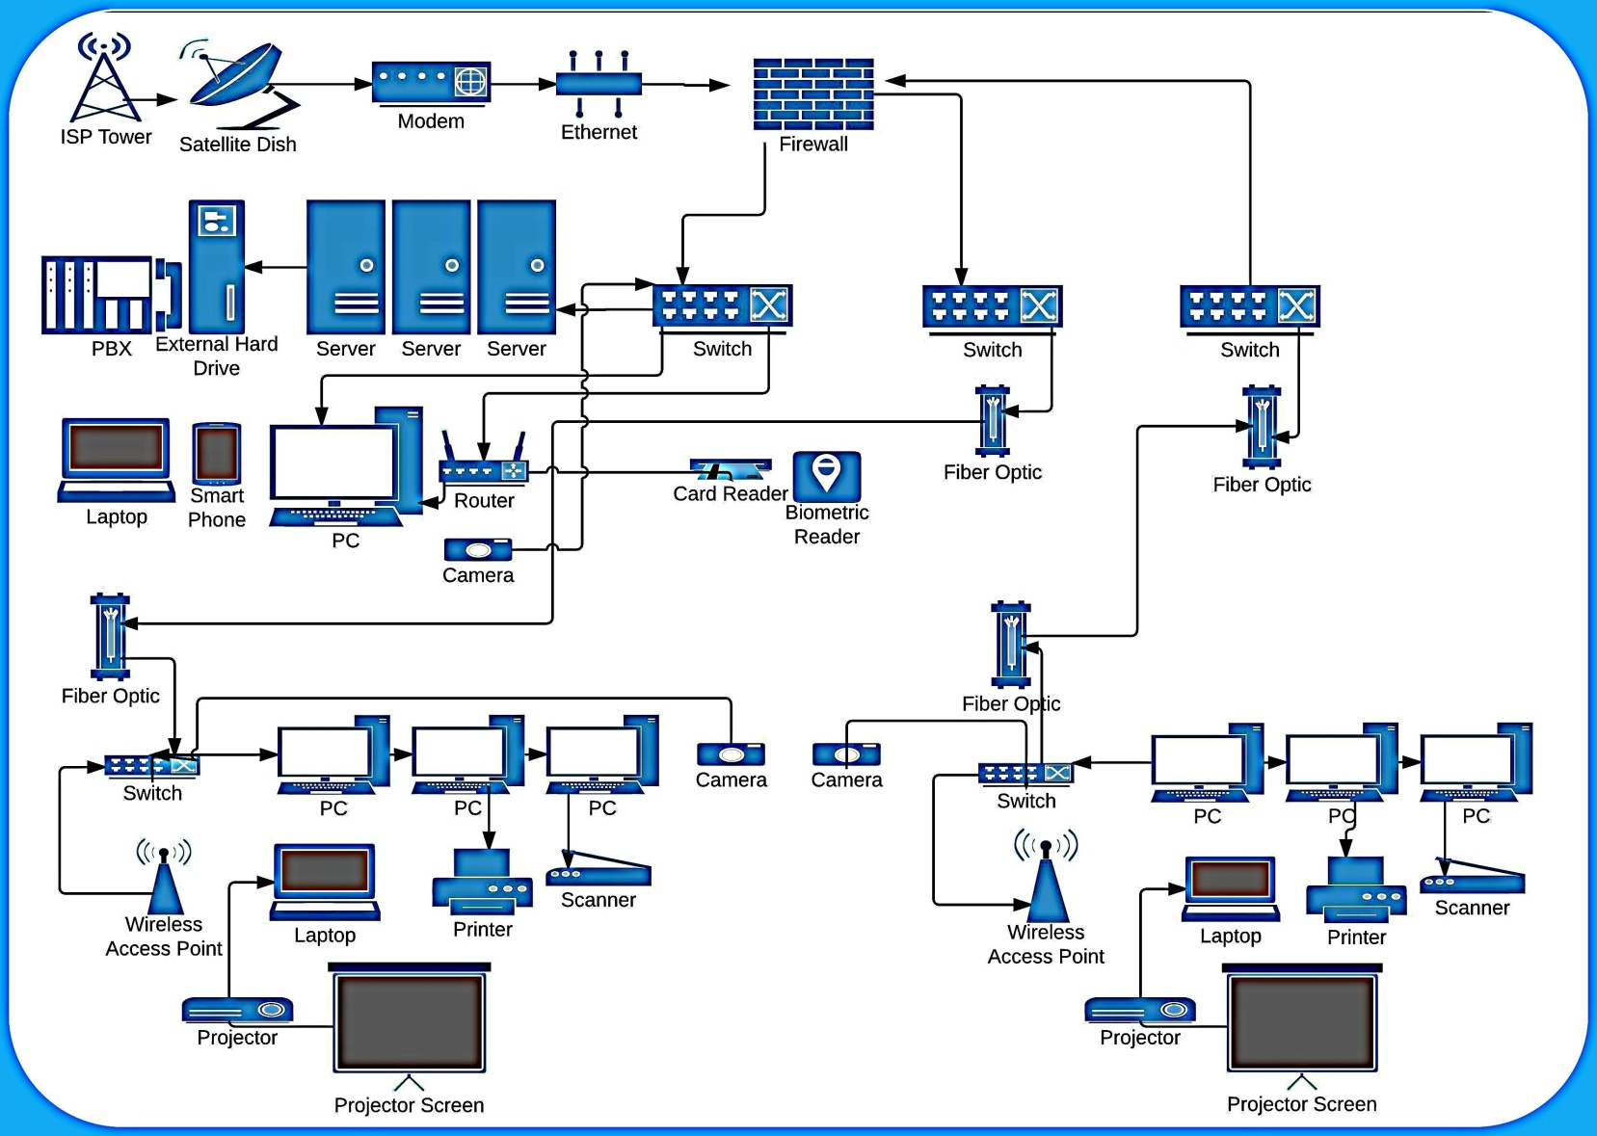
A model of campus Wi-Fi connection

Slide 12
Cost Analysis
S. No. | Item | Quantity | Price in USD | Total
1. | Wireless Access Point(WAP) 2.5Ghz (Cisco 1570 Outdoor Access Point) | 50 | $2,300.00 | $115,000
2. | Wi-Fi Repeaters (Netgear AC1200 Wi-Fi Range Extender EX6150) | 20 | $132 | $2,640
3. | Pipe(for Height to Antenna) | 50 | $20 | $100
4. | Weather Box(Housing) | 50 | $10 | $50
5. | Installation Cost | $85 per hour | 2 technicians (14 hours each) | $2,380
 | Total |  |  | $120,170
Notes:
The prices named above are arrived at after intensive market survey and research on the best available options for equipment. The prices are subject to change due to market factors. The total amount indicated above might also change if there is any need for cabling. The budget was prepared based on the assumption that effective cabling has already been established to support the WLAN project.

Slide 13
Conclusion
The proposal has inferred to the use of the best equipment to offer standard and reliable Wi-Fi for the campus. The total cost would have been less than the one quoted above. However, for the interest of the numbers of users and expected traffic, it was imperative to target access points that have the capacity to both support many users (approximately 256 students at once).

Slide 14
Cheaper options
There are cheaper alternatives provided above incase the campus is working on a tight budget on the project of Wi-Fi installation. One of the setbacks of using a shared bandwidth in Wi-Fi systems is that it is not as reliable in performing its uses. As such, it is faced with downtimes, lags and might be relatively slow.

Slide 15
end

Slide 16
References
Vitek, C. A. (2016). U.S. Patent No. 9,456,357. Washington, DC: U.S. Patent and Trademark Office.
Walia, J. S., Hämmäinen, H., & Matinmikko, M. (2017, November). 5G Micro-operators for the future campus: A techno-economic study. In 2017 Internet of Things Business Models, Users, and Networks (pp. 1-8). IEEE.
Naughton, J. (2016). The evolution of the Internet: from military experiment to General Purpose Technology. Journal of Cyber Policy, 1(1), 5-28.

